Slide 1
Grammars and Context Free Languages Lecture 4
John P. Baugh, Ph.D. University of Michigan - Dearborn

Slide 2
Introduction
We have largely focused on recognizing languages with finite automata and describing languages
A grammar is used to generate a language
This is what we will focus on in this chapter
Additionally, we will explore context-free grammars, which are a more powerful way of describing languages than the regular expressions and regular languages from before
Namely, we discuss context-free languages (CFLs)
Then, we will discuss a type of automaton that is capable of recognizing a context-free language, namely, the pushdown automaton)
Finite automata are only capable of recognizing regular languages
Since not all CF languages are regular, we need a more powerful machine to help us!

Slide 3
Lecture 4 Contents
Grammars
Backus Normal Form (BNF)
Parse Trees
Ambiguity
Context Free Languages
Design a CFG to generate a given CFL
Chomsky Normal Form (CNF)
Pushdown Automata

Slide 4
Grammars
Irony? You ain’t see nothin’ yet!

Slide 5
Grammars
While automata are used to recognize languages, grammars are used to construct languages
They are the primary tool used in construction of programming languages, scripts, etc.
Grammar deals with the syntax of a language, but doesn’t deal with semantics (meaning)
Syntax error at compile time in a programming language is a violation of the grammar of that language
Fatal run-time errors and logic errors are semantic errors

Slide 6
Grammars
Consider two sets
T = {John, Kiumi, eats, sings, talks}
N = {S, noun, verb}
The first set, T, are of terminals
These are similar to actual literals or values used in a programming language
The second set, N, are of non-terminals, or variables
These are similar to variables in a programming language
Non-terminals are ultimately replaced by terminals
Example: S is the sentence non-terminal:
S→noun verb
S→John verb
S→John eats

Slide 7
Grammars: Formal Definition
A grammar for a language is a collection of three things
A finite set of terminal characters, Σ (Sigma)
A finite set of non-terminal characters, Γ (Gamma)
One of the symbols is denoted S for the starting non-terminal
When it is possible, we usually capitalize the non-terminals to distinguish them from terminals
A finite set of rules, also called productions for replacing expressions containing non-terminals

Slide 8

Context-Free Grammars and Languages
A context-free grammar (CFG) is a grammar where all the productions are of the form:
Non-Terminal → Finite string of terminal and non-terminals
A context-free language (CFL) is a language generated by a context-free grammar
The process of using productions (rules) to convert the starting non-terminal S into a string of terminals is called a derivation
We use the symbol → or $⇒$ to indicate that a production has been used

Slide 9
CFL Example 1
Let Σ = {a, λ} and let Γ = {S} and let the two productions be:
S → Sa
S → λ
Using the above, we can derive that:
S → λ
S→ Sa → λa = a
S→ Sa → Saa → λaa = aa
We conclude that the language generated by this grammar is {λ, a, aa, aaa, …} = a*
Isn’t that a regular language though?
Yes! CF grammar can be used to describe regular languages, but not all CF languages are regular

Slide 10
CFL Example 2
Let Σ = {a, b} and let Γ = {S} and let the three productions be:
S → aS
S → bS
S → abba
Using the above, we can derive that:
S → abba
S → aS → aabba (using S = abba)
S → bS → babba (using S = abba)
S → aS → aaS → aaabba (using S = aS, and then S = abba)
S → bS → baS → baabba (using S = bS, and then S = abba)
We can see this language is {abba, aabba, babba, …} = (a + b)*abba
In other words, this is the language of any string using a’s and b’s, ending in abba

Slide 11
Backus Normal Form (BNF)
Throughout computer science and software engineering, the topic of normalization comes up frequently
We can think of normalization as simply removing redundancies and reducing something into a more standard, compact form
BNF (Backus Normal Form or Backus-Naur Form)
After John Backus and Peter Naur
This form is a slight variation on what we’ve used thus far, except we allow for saving space using the | (or) symbol in productions
Example:
N → stuff1
N → stuff2
Can be reduced to:
N → stuff1 | stuff2

Slide 12
BNF Example
The grammar from earlier:
S → aS
S → bS
S → abba
We can reduce this grammar using BNF:
S → aS | bS | abba

Slide 13
CFL Example 3
This time we will use BNF initially
Let Σ = {a, b, λ} and let Γ = {S} and let the two productions be:
S → aSb | λ
Using the above, we can derive the following:
S → λ
S → aSb → a λb = ab
S → aSb → aaSbb → aa λbb = aabb
S → aSb → aaSbb → aaaSbbb → aaa λbbb = aaabbb
So it appears our language is “growing from the center”
that is: {ab, aabb, aaabbb, …}
So, we can say this is the language a^{n}b^{n}
We recognize this language from previous discussions! So, our CFG can generate non-regular languages

Slide 14
Parse Trees
Another way of representing derivations of words from a grammar uses a parse tree
Also called syntax trees, generation trees, production trees, and derivation trees
The tree starts with the starting S non-terminal at the root, and illustrates the production to form a single string
Consider a derivation S → Sa → ba
This would be drawn as seen to the right

Slide 15
Parse Tree Example 1
A more complex derivation, with :
The terminals, Σ = {a, b} and non-terminals/variables, Γ = {S, X, Y}
In this derivation, the leftmost non-terminal will be replaced next at each step
This is called a leftmost derivation
S → aXYb → aaYb → aabXb → aabab

Slide 16
Total Language Tree
Another type of tree can also be used to show all words generated by the grammar
This type of tree is called a total language tree
The interior nodes (non-leaf nodes, and non-root) contain working strings
A working string is a string that can contain both terminal and non-terminal characters

Slide 17
Total Language Tree Example 1
For the following CF grammar, draw a portion of the total language tree
S → AB | aA
A → a
B → ba

Slide 18
Total Language Tree Example 2
Draw the portion of the total language tree including all strings of less than 5 letters for the following grammar
S → aaS | Sb | b

Slide 19
Ambiguity
Sometimes the effect of the productions is not unique in that a different sequence of productions can be used to generate the same string
If a string has two distinct parses, then the string can have two distinct meanings
This is an undesirable property of grammars
A grammar is called ambiguous if there exists a string w which can be generated with two (or more) distinct leftmost derivations

Slide 20
Ambiguity: Example 1
Consider the following grammar
Let Σ = {a} and let Γ = {S} and the following productions are
S → aS
S → Sa
S → a
Then, the string aaa, for example, can be derived in four distinct leftmost derivations:
S → aS → aaS → aaa //replace initial S with aS, then the S with a
S → aS → aSa → aaa //replace initial S with Sa, then the S with a
S → Sa → aSa → aaa //replace initial S with aS, then the S with a
S → Sa → Saa → aaa //replace initial S with Sa, then the S with a
Therefore, the grammar is ambiguous

Slide 21
Context-Free Languages
“They may take our lives, but they’ll never take our freedom” – William Wallace (Braveheart)

Slide 22
Context-Free Grammars
As review, a grammar consists of a collection of
Terminals, Σ
Non-terminals (also called Variables), Γ
Productions
Also called substitution rules, or just rules
One variable is considered the start variable
And again, formally, a context free grammar is a grammar where all the productions are of the form:
Non-Terminal → finite string of terminals and non-terminals

Slide 23
Context-Free Grammars
We can state our process of describing a language using a grammar differently, by generating each string of that language in the following manner
Write down the start variable. It is the variable on the left-hand side of the top rule (production) unless otherwise indicated
Find a variable that is written down and a rule that starts with that variable (non-terminal). Replace the written down variable with the right-hand side of that rule
Repeat step 2 until there are no variables remaining

Slide 24
Context-Free Grammars Example 1
The following is an example of a context-free grammar, which we will call G₁
A → 0A1
A → B
B → c
As an example, we can see the G₁ grammar generates the string 000c111
Again, the sequence of substitutions used to obtain this string is called a derivation
A derivation of 000c111 in grammar G₁ is:
A → 0A1 → 00A11 → 000A111 → 000B111 → 000c111
All strings that can be generated in this way make up the language of the grammar
We can write L(G₁) to indicate the Language of grammar G₁
We can also see that this is, L = {0^{n}c1^{n} : n ≥ 0}

Slide 25
Context-Free Grammars Example 2
Another example of a context-free grammar, called G₂, describes a fragment of the English language
<Sentence> → <Noun-Phrase><Verb-Phrase> <Noun-Phrase> → <Cmplx-Noun> | <Cmplx-Noun><Prep-Phrase> <Verb-Phrase> → <Cmplx-Verb> | <Cmplx-Verb><Prep-Phrase> <Prep-Phrase> → <Prep><Cmplx-Noun> <Cmplx-Noun> → <Article><Noun> <Cmplx-Verb> → <Verb> | <Verb><Noun-Phrase> <Article> → a | the <Noun> → professor | cupcake | computer <Verb> → touches | likes | eats <Prep> → with

Slide 26
Context-Free Grammars Example 2
Using our Grammar G₂, we have 10 non-terminals (variables, the capitalized terms inside brackets)
We have 9 terminal strings
Full English would include constructions of strings using 27 terminal characters (English alphabet plus a space character)
We have 18 rules
Some strings in the language, L(G₂) include:
a professor eats
a professor likes a computer
the computer eats a cupcake
the professor touches the computer with a cupcake

Slide 27
Context-Free Grammars Example 2
We can show a derivation of our first string in the list
a professor eats
<Sentence> → <Noun-Phrase><Verb-Phrase>
→ <Cmplx-Noun><Verb-Phrase> → <Article><Noun><Verb-Phrase> → a <Noun><Verb-Phrase> → a professor <Verb-Phrase> → a professor <Cmplx-Verb>
→ a professor <Verb> → a professor eats

Slide 28
CF Grammars Example 3
Consider the grammar G₃
Σ = {a, b} //we could also include λ formally
Γ = {R, S}
G₃ has production rules
S → aSb | SS | λ
This grammar generates strings such as abab, aaabbb, and aababb.
abab: S→SS → aSbaSb → aλbaλb = abab
aaabbb: S→ aSb → aaSbb → aaaSbbb → aaaλbbb = aaabbb
aababb: S→ aSb → aSSb → aaSbSb → aaλbSb = aabSb → aabaλbb = aababb
Note that if you replace all a’s with a left parenthesis, “(“, and all b’s with the right parenthesis, “)”, you have the language L(G₃) of all strings of properly nested parentheses!

Slide 29
Design a CFG to generate a CFL
Formalizing a skill you need for quiz and test purposes, given a CFL, find the grammar that generates it
Just like with regular language and finite automata, this requires creativity
In fact, CFGs are even trickier to construct than say, finite automata
Why? Because we are more accustomed to programming a machine for specific tasks than for describing languages with grammars

Slide 30
Design a CFG to generate a CFL
Useful techniques recommended by MIT professor, Dr. Michael Sipser are as follows:
Many CFLs are the unions of simpler CFLs
If you must construct a CFG for a CFL that you can break into smaller pieces, do so!
After this, construct individual grammars for each piece
Then, merge the individual pieces into a grammar for the original language by combining their rules
Also, add a new rule: S→ S₁ | S₂ | … | S_{k} where S_{i} non-terminals (variables) are the start variables for your individual sub-grammars

Slide 31

Designing CFGs: Example 1
Given the language L = {0^{n}1^{n} : n ≥ 0} $∪$ {1^{n}0^{n} : n ≥ 0), construct the grammar
First, we can break this into two sub-grammars:
S₁ → 0S₁1 | λ
S₂ → 1S₂0 | λ
So, we can combine these sub-grammars, recognizing the correlation between the OR operator, |, and union:
S → S₁ | S₂
S₁ → 0S₁1 | λ
S₂ → 1S₂0 | λ

Slide 32
Design a CFG to generate a CFL
More techniques recommended by MIT professor, Dr. Michael Sipser include:
Certain CF languages contain strings with two substrings that are “linked” in the sense that a machine for such a language would need to remember an unbounded amount of information about one of the substrings
In order to verify that it corresponds properly to the other substring
This definitely occurs in the language we say, {0^{n}1^{n} : n ≥ 0 }
We have to remember the number of 0’s, so we can then make sure we have the correct number of 1’s
Frequently, a CFG can be constructed to handle this situation by using a rule of the form:
R → uRv
Which generates strings containing the same number of u’s, corresponding to v’s

Slide 33
Chomsky Normal Form (CNF)
It is convenient to have CFGs in a simplified form
One of the most simple and most useful forms is Chomsky normal form, or CNF
A context-free grammar is in Chomsky normal form if every rule is of the form
A → BC
A → a
Where a is any terminal, and A, B, and C are non-terminals (variables)
B and C may not be the start variable
We also permit S → λ where S is the start non-terminal (variable)
Any context-free language can be generated by a context-free grammar in Chomsky normal form

Slide 34
Converting a grammar into CNF
We can convert any grammar G into Chomsky normal form
The conversion has several stages that consist of replacing rule-violating conditions with those that follow the rules of CNF
This technique is Sipser’s technique and is slightly different from that found in the book
Overall steps:
Add a new start variable
Eliminate all λ-rules of the form A → λ
Eliminate all unit rules of the form A → B
Convert any remaining rules to the proper form

Slide 35
Converting a grammar into CNF
Overall steps:
Add a new start variable
Add a new start variable S₀ and the rule S_{o} → S, with S being the original start variable
This change guarantees that the start variable doesn’t occur on the right-hand side of a rule
Eliminate all λ-rules of the form A → λ
When A is not a start variable, we remove all A → λ
Then, for each occurrence of an A on the right-hand side of a rule, we add a new rule with that occurrence deleted
In other words, R → uAv is a rule in which u and v are strings of non-terminals and terminals, we add rule R→uv
If we have R → uAvAw (multiple occurrences of A), then we add rules:
R → uvAw, R → uAvw, and R → uvw
If we have a rule R→A, we add R→ λ unless we previously removed the rule R → λ

Slide 36
Converting a grammar into CNF
Eliminate all unit rules of the form A → B
We remove a unit rule A → B
Whenever a rule B → u appears, we add the rule A → u unless this was a unit rule previously removed
As before, u is a string of variables and terminals, in this case
We repeat these steps until we eliminate all unit rules
Convert any remaining rules to the proper form
We replace each rule A → u₁u₂…u_{k} where k ≥ 3 and each u_{i} is a non-terminal OR terminal symbol with rules A → u₁A₁, A₁ → u₂A₂, etc.
The A_{i}’s are new variables (non-terminals)

Slide 37
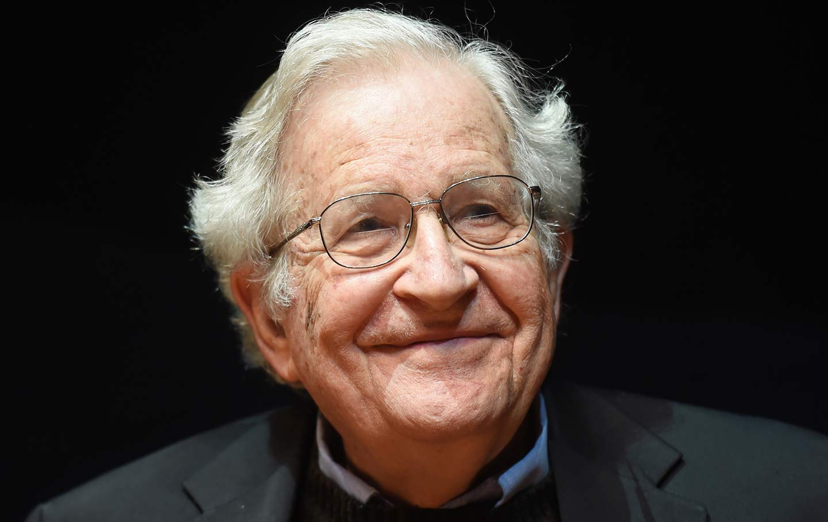
CNF: More Information
You should be able to recognize a grammar in CNF, but you won’t be responsible for the conversion for test and quiz purposes
By the way, Chomsky is still alive – he’s over 92 years old! (born 1928)

Slide 38
Pushdown Automata
“You come push it… you push it real good.” – Mr. Slowsky
https://youtu.be/YVCwVF0zbI8

Slide 39
Pushdown Automata
When we discussed regular languages, we devised a machine called a finite automaton, or FA (also, a DFA, or deterministic finite automaton)
For regular languages, FA work well
But, when certain situations arise – counting the number of a’s or b’s (or 0’s or 1’s) in a language like { 0^{n}1^{n} : n ≥ 0 }, FA fail miserably
They lack the extra memory to track things like counting
We introduce pushdown automata, which are more powerful than FA
They are like FA, but also have the extra memory we need, in the form of a stack
So, the FA was a good model of a simple CPU – it could process things, but had little memory
PDA are like FA, but with auxiliary memory in the form of a stack

Slide 40
Pushdown Automata
Pushdown automata (specifically nondeterministic PDA) are equivalent to context-free grammars
This is in the same way that finite automata are equivalent to regular expressions
So, we can prove a language is context-free if one or both of the following holds:
We can develop a context-free grammar to generate it
We can create a PDA that recognizes it

Slide 41
FA vs PDA
PDA have a stack as auxiliary memory They determine state and interactions based on input and stack top
A PDA can write symbols to the stack and read them back later
FA
PDA
a
a
b
a
…
a
a
b
a
…
input
input
FA have no auxiliary memory.
They determine state based on
the input and transition function
x
Stack
y
z
…

Slide 42
Pushdown Automata
At any time, a PDA can write onto the top of the stack
Essentially, it pushes down the other symbols on the stack
Hence, pushdown automata
Writing to the stack is pushing
Removing a symbol from the stack is popping
Remember a stack is LIFO, so all reading/writing is done at the top of the stack
Recall that a FA cannot recognize a language like 0^{n}1^{n} because it can’t keep track of the number of 0’s, to then match up with the number of 1’s
With a PDA, we have a stack, which is unbounded in nature and allows us to accomplish this task

Slide 43
PDA: Informal Example
Informally, we consider our language {0^{n}1^{n} : n ≥ 0 }
How does the PDA work for this language?
Read symbols from the input
As each 0 is read, push it onto the stack
As soon as 1s are seen, pop a 0 off the stack for each 1 read
If reading the input is finished exactly when the stack becomes empty of 0s, accept the input
If the stack becomes empty while 1s remain reject the input
if the 1s are finished while the stack still contains 0s reject the input
if any 0s appear in the input following 1s, reject the input

Slide 44
PDA: Formal Definition
Elenbogen/Baugh definition:
A pushdown automaton is a collection of four things:
A finite alphabet Σ of input characters
A finite set of states Ω at least one of which is denoted as a start state
A finite set of stack characters Π (one of which is Z)
A finite set of transitions between the states of the form read, pop; push

Slide 45
PDA: Example 1
Language {a^{n}b^{n} : n ≥ 0}
Idea
read an a, push a onto the stack
read a b, pop an a from the stack
The stack should be empty, and PDA should be out of input, then we accept

Slide 46
PDA: Example 1
The book is a bit squirrely… the symbols used are a little confusing, so hopefully we can clarify them a bit here
Remember the form used in Elenbogen/Baugh, also used in JFLAP simulator:
Read, pop; push – this corresponds to reading the input, popping/reading item on stack and then pushing something onto the stack
λ means to ignore or skip whichever step it appears in
Z is the “initial bottom of stack symbol”
E.g.:
a, λ; a means :
“read an “a”, don’t pop anything off the stack; push an a onto the stack”
b, a; λ means :
“read a “b”, you better pop an a off the stack; don’t push anything onto the stack”

Slide 47
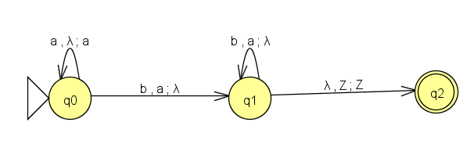
PDA: Example 1
Language {a^{n}b^{n} : n ≥ 0}
Read, pop; push – this corresponds to reading the input, popping/reading item on stack and then pushing something onto the stack

Slide 48
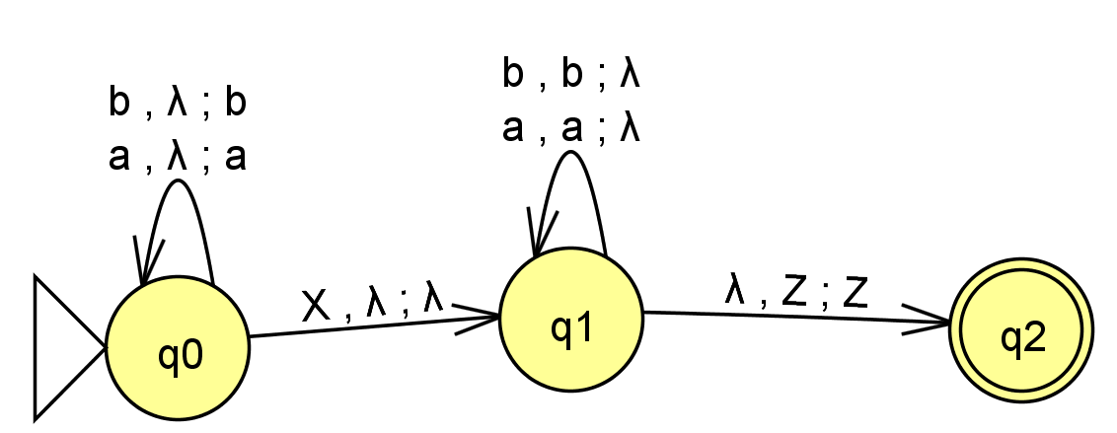
PDA: Example 2
PDA for the language EvenPalindromeX
abXba
Read, pop; push – this corresponds to reading the input, popping/reading item on stack and then pushing something onto the stack

Slide 49
What skills to know?
While all of the information in these slides are up for grab (unless otherwise specified), the major things you need to know how to do by the next quiz are:
Given a CFG, perform a derivation of a particular string
Convert an arbitrary CFG into Backus Normal Form CFG
Represent a context-free language using a pushdown automaton
Given a context-free language, find a context-free grammar that generates that language

Slide 50
Questions?
Questions?
Comments?
Remarks?

